Slide 1
Chapter 12: Regression and Correlation

Slide 2
Introduction
Correlation.
Regression.
Bivariate regression.
Multiple regression.
Notes:
Satisfies Learning Objective 12.1: Describe linear relationships and prediction rules for bivariate and multiple regression models.
Correlation: A measure of association used to determine the existence and strength of the relationship between variables and is similar to the proportional reduction of error (PRE).
Regression: A linear prediction model, using one or more independent variables to predict the values of a dependent variable.
Bivariate regression: Examines how changes in one independent variable affects the value of a dependent variable.
Multiple regression: Estimates how several independent variables affect one dependent variable.

Slide 3
The Scatter Diagram
Scatter diagram or scatterplot.
May reveal negative association.
Notes:
Satisfies Learning Objective 12.1: Describe linear relationships and prediction rules for bivariate and multiple regression models.
Scatter diagram or scatterplot: Visual method used to display the relationship between two interval-ratio variables. It is used as a first exploratory step in regression analysis, a scatter diagram can suggest whether two variables are associated.
May reveal negative association: Scatter diagrams may also reveal a negative association between two variables or no relationship at all.

Slide 4
Linear Relationships and Prediction Rules (1 of 8)
Linear relationship.
Deterministic relationship.
Notes:
Satisfies Learning Objective 12.1: Describe linear relationships and prediction rules for bivariate and multiple regression models.
Linear relationship: Allows to approximate the observations displayed in a scatter diagram with a straight line.
Deterministic relationship: In a perfectly linear relationship, all the observations (the dots) fall along a straight line (a perfect relationship is sometimes called a deterministic relationship), and the line itself provides a predicted value of Y (the vertical axis) for any value of X (the horizontal axis).

Slide 5
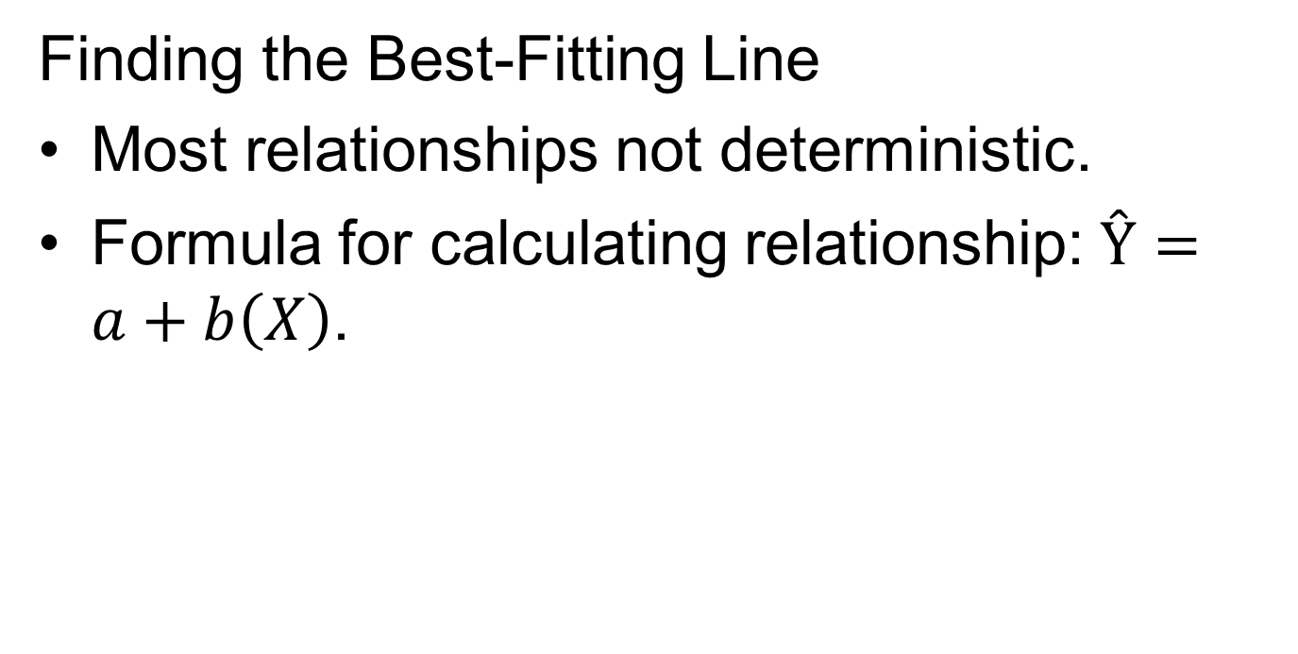
Linear Relationships and Prediction Rules (2 of 8)
Finding the Best-Fitting Line
Most relationships not deterministic.
Formula for calculating relationship: Ŷ$=a+b\left(X\right)$.
Notes:
Satisfies Learning Objective 12.2: Construct and interpret straight-line graphs and best-fitting lines.
Most relationships not deterministic: Most relationships we study in the social sciences are not deterministic, and we are not able to come up with a linear equation that allows us to predict Y from X with perfect accuracy.
Formula for calculating relationship:
$$\text{Ŷ} =a+b\left(X\right)$$
where Ŷ is the predicted score on the dependent variable, X is the score on the independent variable, a is the Y-intercept, or the point where the line crosses the Y-axis; therefore,
a is the value of Y when X is 0, b is the slope of the regression line, or the change in Y with a unit change in X.

Slide 6
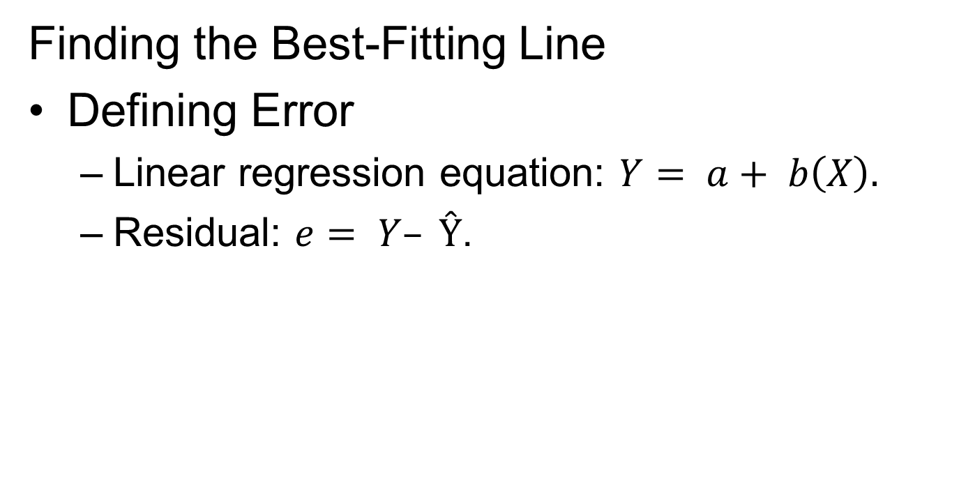
Linear Relationships and Prediction Rules (3 of 8)
Finding the Best-Fitting Line
Defining error
  Linear regression equation: $Y= a+ b\left(X\right).$
  Residual: $e= Y–\text{Ŷ}$.
Notes:
Satisfies Learning Objective 12.2: Construct and interpret straight-line graphs and best-fitting lines.
Defining error:
The best-fitting line is the one that generates the least amount of error, also referred to as the residual.
There are two values for Y: (1) a predicted Y, which we symbolize as Ŷ and which is generated by the prediction equation, also called the linear regression equation $Y= a+ b(X)$, and (2) the observed Y, symbolized simply as Y.
Residual is the difference between the observed Y and the predicted Ŷ. If we symbolize the residual as e, then: $e= Y–\text{Ŷ}$.

Slide 7
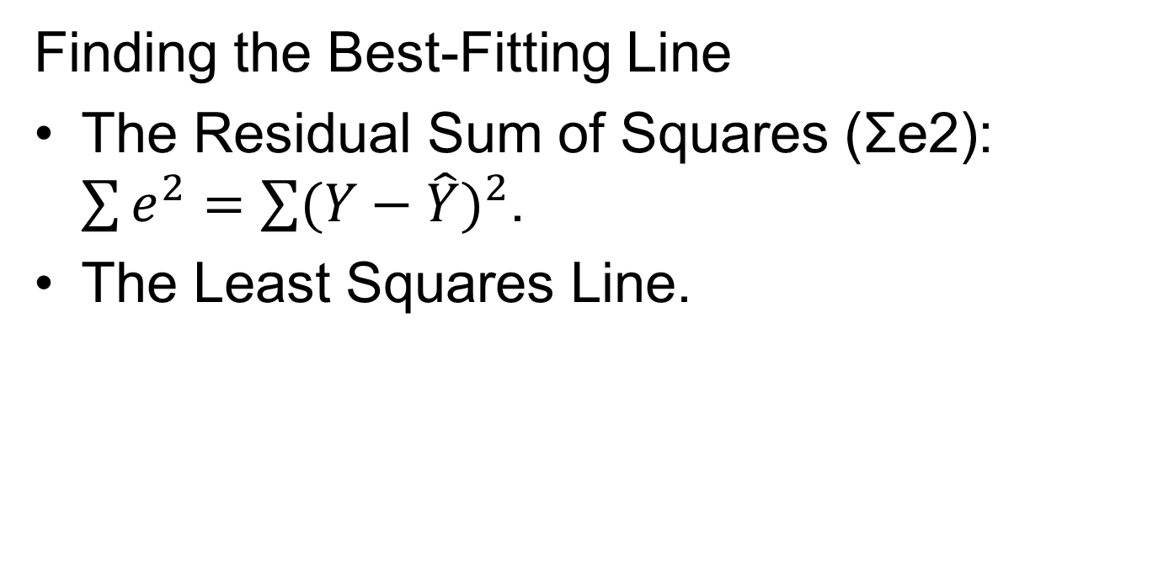
Linear Relationships and Prediction Rules (4 of 8)
Finding the Best-Fitting Line
The residual sum of squares (Σe²): $\sum{e^{2}}=\sum{{(Y−\hat{Y})}^{2}}$.
The least squares line.
Notes:
Satisfies Learning Objective 12.2: Construct and interpret straight-line graphs and best-fitting lines.
The residual sum of squares (Σe²): Statisticians prefer to work with the third method: Squaring and summing the residuals over all observations. The result is the residual sum of squares, or Σe². Symbolically, Σe² is expressed as: $\sum{e^{2}}$=$\sum{{(Y−\hat{Y})}^{2}}$.
The least squares line:
The best-fitting regression line is that line where the sum of the squared residuals, or Σe², is at a minimum.
Such a line is called the least squares line and the technique that produces this line is called the least squares method.
The technique involves choosing a and b for the equation such that Σe² will have the smallest possible value.

Slide 8
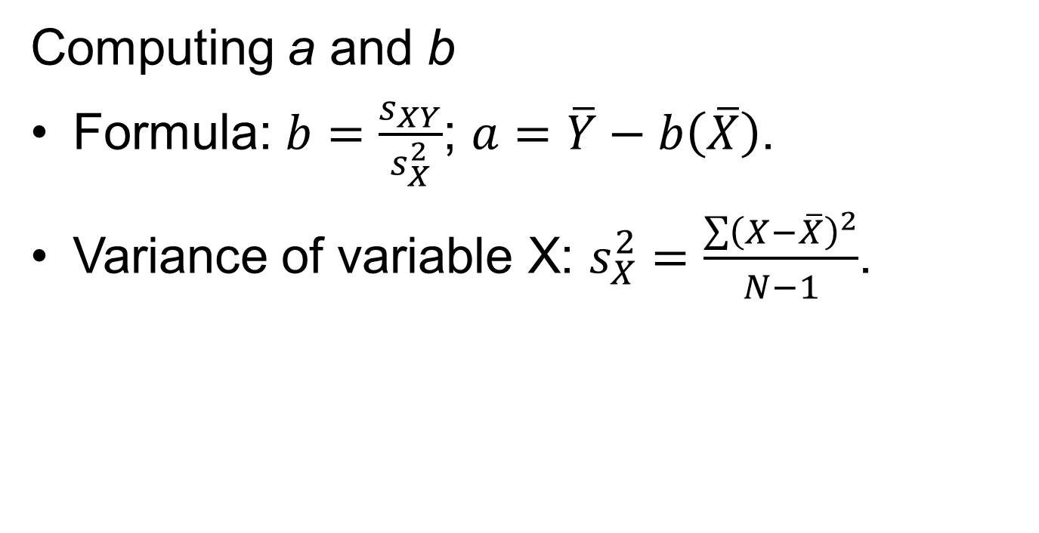
Linear Relationships and Prediction Rules (5 of 8)
Computing a and b
Formula: $b=\frac{s_{XY}}{s_{X}^{2}}$; $a=\overline{Y}−b\left(\overline{X}\right)$.
Variance of variable X: $s_{X}^{2}=\frac{\sum{{\left(X−\overline{X}\right)}^{2}}}{N−1}$.
Notes:
Satisfies Learning Objective 12.3: Calculate and interpret a and b.
Formula: To figure out the values of a and b in a way that minimizes $\sum{e^{2}}$, we need to apply the following formulas:
$b=\frac{s_{XY}}{s_{X}^{2}}; a=\overline{Y}−b\left(\overline{X}\right)$.
where $s_{XY}$ is the covariance of X and Y, $s_{X}^{2}$is the variance of X, $\overline{Y}$is the mean of Y, $\overline{X}$is the mean of X, a is the Y-intercept, b is the slope of the line.
Variance of variable X: $Variance \left(X\right)=s_{X}^{2}=\frac{\sum{{\left(X−\overline{X}\right)}^{2}}}{N−1}.$The denominator for b is the variance of the variable X.

Slide 9

Linear Relationships and Prediction Rules (6 of 8)
Computing a and b
Covariance of X and Y: $s_{XY}=\frac{\sum{\left(X−\overline{X}\right)\left(Y−\overline{Y}\right)}}{N−1}.$
Reflects on strength and direction.
Notes:
Satisfies Learning Objective 12.3: Calculate and interpret a and b.
Covariance of X and Y: $Covariance \left(X,Y\right)=s_{XY}=\frac{\sum{\left(X−\overline{X}\right)\left(Y−\overline{Y}\right)}}{N−1}. \text{The} \text{numerator} \left(S_{XY}\right)\text{, }\text{however}\text{, }\text{is} \text{a} \text{new} \text{term}\text{. }\text{It} \text{is} \text{the} \text{covariance} \text{of} \text{X} \text{and} \text{Y}$.
Reflects on strength and direction: The covariance is a measure of the linear relationship between two variables, and its value reflects both the strength and the direction of the relationship.
The covariance will be close to zero when X and Y are unrelated.
It will be larger than zero when the relationship is positive and smaller than zero when the relationship is negative.

Slide 10
Linear Relationships and Prediction Rules (8 of 8)
Interpreting a and b
Best possible guess for association.
Regression line and Y-axis intersection.
Plotting the regression equation.
Notes:
Satisfies Learning Objective 12.3: Calculate and interpret a and b.
Best possible guess for association: The pattern suggested by the regression equation may not hold for every individual, it gives us a tool by which to make the best possible guess about how Internet usage is associated, on average, with educational attainment.
Regression line and Y-axis intersection: The Y intercept a is the predicted value of Y, when $X = 0$. Thus, it is the point at which the regression line and the Y-axis intersect.
Plotting the regression equation: One can plot the regression equation with two points:
The mean of X and the mean of Y.
0 and the value of a.

Slide 11
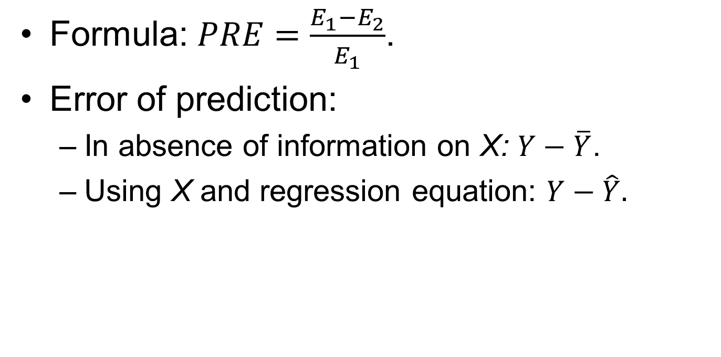
Methods for Assessing the Accuracy of Predictions (1 of 6)
Formula: $PRE=\frac{E_{1}−E_{2}}{E_{1}}$.
Error of prediction:
  In absence of information on X: $Y−\overline{Y}$.
  Using X and regression equation: $Y−\hat{Y}.$
Notes:
Satisfies Learning Objective 12.4: Calculate and interpret the coefficient of determination (r²) and Pearson’s correlation coefficient (r).
Formula to calculate PRE:
$$PRE=\frac{E_{1}−E_{2}}{E_{1}}$$
where $E_{1}$ is the prediction errors made when the independent variable is ignored and
$E_{2}$ is the prediction errors made when the prediction is based on the independent variable.
Error of prediction:
The first prediction rule is in the absence of information on X, predict $\overline{Y}$. The error of prediction is defined as $Y−\overline{Y}$.
The second rule of prediction uses X and the regression equation to predict $\hat{Y}$. The error of prediction is defined as $Y−\hat{Y}.$

Slide 12
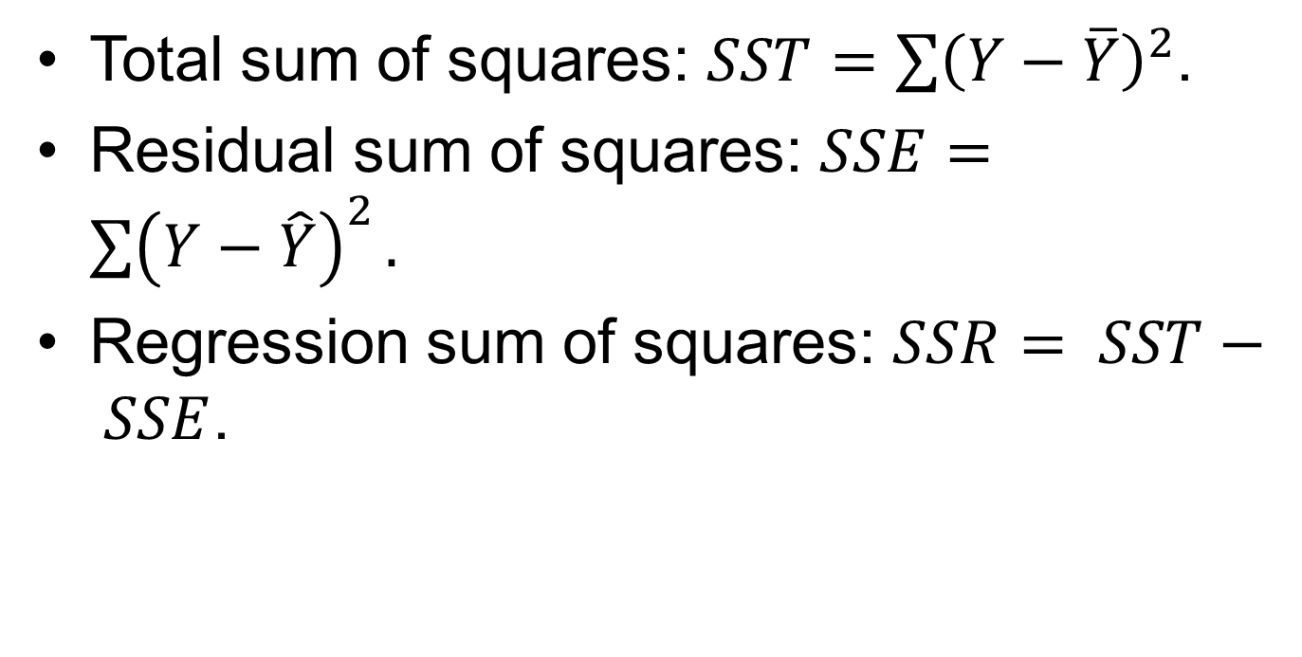
Methods for Assessing the Accuracy of Predictions (2 of 6)
Total sum of squares: $SST=\sum{{\left(Y−\overline{Y}\right)}^{2}}$.
Residual sum of squares: $SSE=\sum{{\left(Y−\hat{Y}\right)}^{2}}.$
Regression sum of squares: $SSR= SST− SSE$.
Notes:
Satisfies Learning Objective 12.4: Calculate and interpret the coefficient of determination (r²) and Pearson’s correlation coefficient (r).
Total sum of squares or SST: The sum of the squared deviations from the mean is called the total sum of squares, or SST:
$SST=\sum{{\left(Y−\overline{Y}\right)}^{2}}$.
Residual sum of squares or SSE: Sum of squared deviations from the regression line is denoted as residual sum of squares, or SSE. $SSE=\sum{{\left(Y−\hat{Y}\right)}^{2}}$.
Regression sum of squares or SSR: By subtracting SSE from SST, we obtain the regression sum of squares, or SSR, which reflects improvement in the prediction error resulting from our use of the linear prediction equation. SSR is defined as$SSR= SST− SSE.$

Slide 13
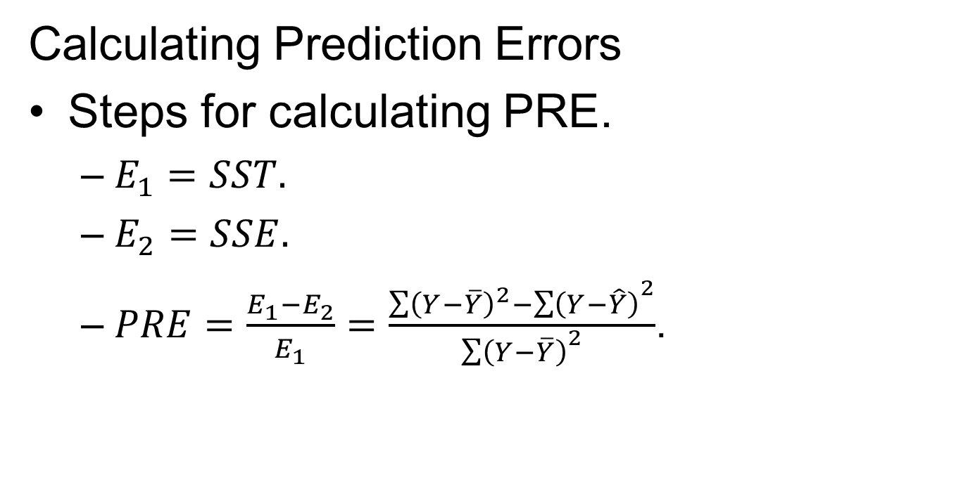
Methods for Assessing the Accuracy of Predictions (4 of 6)
Calculating Prediction Errors
Steps for calculating PRE.
  $E_{1}=SST.$
  $E_{2}=SSE.$
  $PRE=\frac{E_{1}−E_{2}}{E_{1}}=\frac{\sum{{\left(Y−\overline{Y}\right)}^{2}−{\sum{\left(Y−\hat{Y}\right)}}^{2}}}{{\sum{\left(Y−\overline{Y}\right)}}^{2}}$.
Notes:
Satisfies Learning Objective 12.4: Calculate and interpret the coefficient of determination (r²) and Pearson’s correlation coefficient (r).
Steps for calculating PRE:
SST measures the prediction errors when the independent variable is ignored, we can define: $E_{1}=SST.$
Similarly, because SSE measures the prediction errors resulting from using the independent variable, we can define: $E_{2}=SSE.$
We are now ready to define the coefficient of determination, $r^{2}$. It measures the PRE associated with using the linear regression equation as a rule for predicting Y: $PRE=\frac{E_{1}−E_{2}}{E_{1}}=\frac{\sum{{\left(Y−\overline{Y}\right)}^{2}−{\sum{\left(Y−\hat{Y}\right)}}^{2}}}{{\sum{\left(Y−\overline{Y}\right)}}^{2}}$.

Slide 14
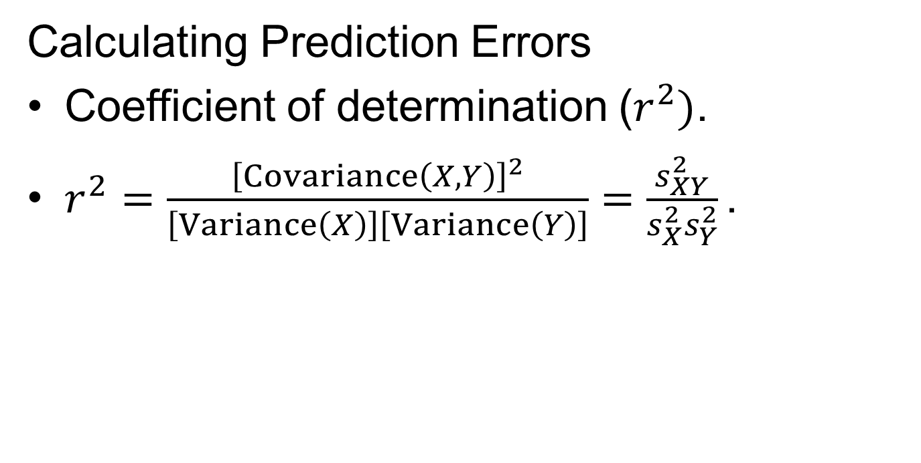
Methods for Assessing the Accuracy of Predictions (5 of 6)
Calculating Prediction Errors
Coefficient of determination ($r^{2})$.
$r^{2}=\frac{{\left[Covariance\left(X,Y\right)\right]}^{2}}{\left[Variance\left(X\right)\right]\left[Variance\left(Y\right)\right]}=\frac{s_{XY}^{2}}{s_{X}^{2}s_{Y}^{2}}\text{.}$
Notes:
Satisfies Learning Objective 12.4: Calculate and interpret the coefficient of determination (r²) and Pearson’s correlation coefficient (r).
Coefficient of determination ($r^{2}$): Reflects the proportion of the total variation in the dependent variable, Y, explained by the independent variable, X. The coefficient of determination ranges from 0.0 to 1.0.
Calculating $r^{2}$: Another method for calculating $r^{2}$ uses the following equation: $r^{2}=\frac{{\left[Covariance\left(X,Y\right)\right]}^{2}}{\left[Variance\left(X\right)\right]\left[Variance\left(Y\right)\right]}=\frac{s_{XY}^{2}}{s_{X}^{2}s_{Y}^{2}}$.
This formula tells us to divide the square of the covariance of X and Y by the product of the variance of X and the variance of Y.

Slide 15

Testing the Significance of $r^{2}$ Using ANOVA (1 of 5)
Need for ANOVA.
ANOVA’s similarity with regression analysis.
Decomposition of total variation.
Notes:
Satisfies Learning Objective 12.6: Test the significance of r² and R² using ANOVA.
Need for ANOVA: ANOVA (analysis of variance) can easily be applied to determine the statistical significance of the regression model as expressed in $r^{2}$.
Similarity with regression analysis: ANOVA and regression analysis can look very much the same. Both methods accounts for variation in the dependent variable in terms of the independent variable, except that in ANOVA the independent variable is a categorical variable and with regression, it is an interval-ratio variable.
Decomposition of total variation: With ANOVA, the total variation in the dependent variable can be decomposed into portions explained (SSB) and unexplained (SSW) by the independent variable.

Slide 16

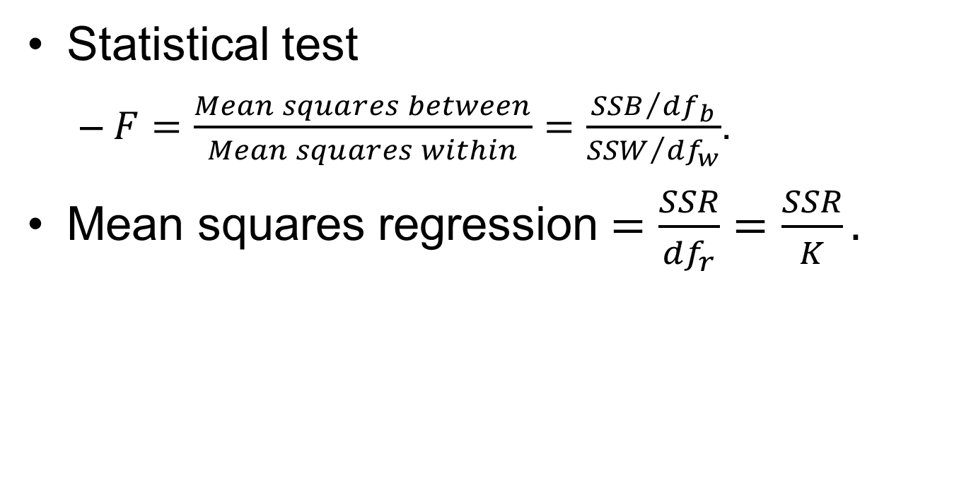
Testing the Significance of $r^{2}$ Using ANOVA (2 of 5)
Statistical test
  $F=\frac{Mean squares between}{Mean squares within}=\frac{{SSB}/{{df}_{b}}}{{SSW}/{{df}_{w}}}$.
Mean squares regression $=\frac{SSR}{{df}_{r}}=\frac{SSR}{K}.$
Notes:
Satisfies Learning Objective 12.6: Test the significance of r² and R² using ANOVA.
Statistical test: The statistical test, F, is the ratio of the mean squares between to the mean squares within as shown in formula: $F=\frac{Mean squares between}{Mean squares within}=\frac{{SSB}/{{df}_{b}}}{{SSW}/{{df}_{w}}}$.
Mean squares regression: Ratio of regression sum of squares (SSR) to the degree of freedom (${df}_{r}$). $Mean squares regression=\frac{SSR}{{df}_{r}}=\frac{SSR}{K}$.

Slide 17

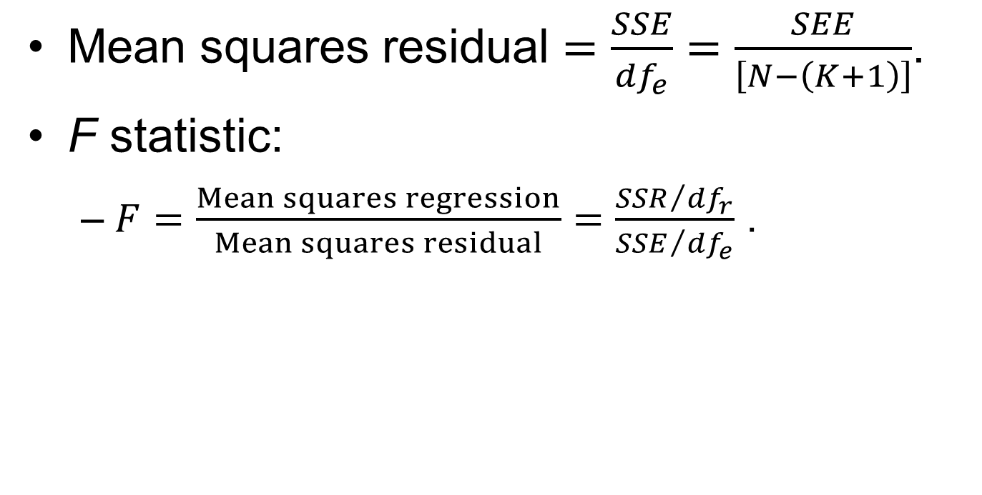
Testing the Significance of $r^{2}$ Using ANOVA (3 of 5)
Mean squares residual $=\frac{SSE}{{df}_{e}}=\frac{SEE}{\left[N−\left(K+1\right)\right]}$.
F statistic:
  $F=\frac{Mean squares regression}{Mean squares residual}=\frac{{SSR}/{{df}_{r}}}{{SSE}/{{df}_{e}}}$.
Notes:
Satisfies Learning Objective 12.6: Test the significance of r² and R² using ANOVA.
Mean squares residual: Ratio of total sum of squares (SST) to the degree of freedom (${df}_{e}$). $Mean squares residual=\frac{SSE}{{df}_{e}}=\frac{SEE}{\left[N−\left(K+1\right)\right]}$.
F statistic: The F statistic is the ratio of the mean squares regression to the mean squares residual: $F=\frac{Mean squares regression}{Mean squares residual}=\frac{{SSR}/{{df}_{r}}}{{SSE}/{{df}_{e}}}$.

Slide 18


Testing the Significance of $r^{2}$ Using ANOVA (5 of 5)
Pearson’s Correlation Coefficient (r)
Formula: $r=\sqrt{r^{2}}$.
Characteristics of Pearson’s r.
Notes:
Satisfies Learning Objective 12.6: Test the significance of r² and R² using ANOVA.
Satisfies Learning Objective 12.4: Calculate and interpret the coefficient of determination (r²) and Pearson’s correlation coefficient (r).
Pearson’s correlation coefficient: The square root of $r^{2}$, or r is most often used as a measure of association between two interval-ratio variables.
Formula: $r=\sqrt{r^{2}}$.
Pearson’s r is usually computed directly by using the following definitional formula: $r^{2}=\frac{\left[Covariance{\left(X,Y\right)}^{2}\right]}{\left[Standard deviation\left(X\right)\right]\left[Standard deviation\left(Y\right)\right]}=\frac{s_{XY}^{2}}{s_{X}s_{Y}}$.
r: r is defined as the ratio of the covariance of X and Y to the product of the standard deviations of X and Y.
Characteristics of Pearson’s r:
Pearson’s r is a measure of relationship or association for interval-ratio variables.
Like gamma, it ranges from $0.0 to ±1.0$, with 0.0 indicating no association between the two variables.
An r of $+1.0$ means that the two variables have a perfect positive association; $–1.0$ indicates that it is a perfect negative association.
The absolute value of r indicates the strength of the linear association between two variables.
Unlike the b coefficient, r is a symmetrical measure. That is, the correlation between X and Y is identical to the correlation between Y and X.

Slide 19
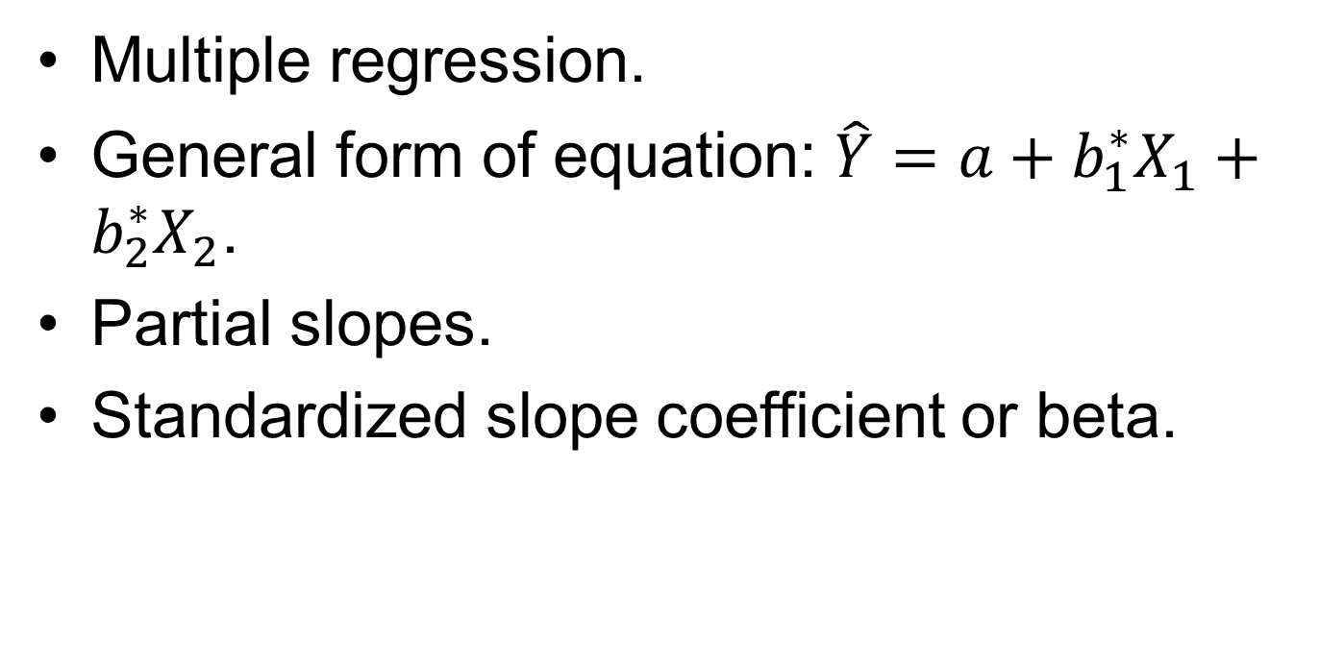
Statistics in Practice: Multiple Regression and ANOVA (1 of 3)
Multiple regression.
General form of equation: $\hat{Y}=a+b_{1}^{∗}X_{1}+b_{2}^{∗}X_{2}$.
Partial slopes.
Standardized slope coefficient or beta.
Notes:
Satisfies Learning Objective 12.5: Interpret multiple regression output.
Multiple regression: An extension of bivariate regression, allowing us to examine the effect of two or more independent variables on the dependent variable.
General form of equation: The general form of the multiple regression equation involving two independent variables:
$$\hat{Y}=a+b_{1}^{∗}X_{1}+b_{2}^{∗}X_{2}$$
where $\hat{Y}$ is the predicted score on the dependent variable, $X_{1}$ is the score on independent variable $X_{1}$, $X_{2}$ is the score on independent variable $X_{2}$, a is the Y-intercept, or the value of Y when both $X_{1}$ and $X_{2}$ are equal to zero, $b_{1}^{∗}$ is the partial slope of Y and $X_{1}$, the change in Y with a unit change in $X_{1}$, when the other independent variable $X_{2}$ is controlled, $b_{2}^{∗}$ is the partial slope of Y and $X_{2}$, the change in Y with a unit change in $X_{2}$, when the other independent variable $X_{1}$ is controlled.
Partial slopes: Reflect the amount of change in Y for a unit change in a specific independent variable while controlling or holding constant the value of the other independent variables.
Standardized slope coefficient or beta: Converts the values of each score into a Z score, standardizing the units of measurement so we can interpret their relative effects. Beta, also referred to as beta weights, range from 0 to ±1.0.

Slide 20
Statistics in Practice: Multiple Regression and ANOVA (2 of 3)
Multiple coefficient of determination.
Pearson’s multiple correlation coefficient.
ANOVA identical to bivariate linear regression.
Notes:
Satisfies Learning Objective 12.5: Interpret multiple regression output.
Multiple coefficient of determination: Measure that reflects the proportion of the total variation in the dependent variable that is explained jointly by two or more independent variables, symbolized as $R^{2}$ (corresponding to $r^{2}$ in the bivariate case).
Pearson’s multiple correlation coefficient: It measures the linear relationship between the dependent variable and the combined effect of two or more independent variables.
ANOVA identical to bivariate linear regression: The ANOVA summary table for multiple regression is nearly identical to the one for bivariate linear regression, except that the degrees of freedom are adjusted to reflect the number of independent variables in the model.

Slide 21
Statistics in Practice: Multiple Regression and ANOVA (3 of 3)
SPSS can produce correlation matrix.
Features of correlation matrix.
Three pairs of extensive correlation.
Notes:
Satisfies Learning Objective 12.5: Interpret multiple regression output.
SPSS can produce correlation matrix: A table that presents the Pearson’s correlation efficient for all pairs of variables in the multiple regression model.
Features of correlation matrix: Provides a baseline summary of the relationships between variables, identifying relationships or hypotheses that are usually the main research objective.
Three pairs of extensive correlation:
Internet hours with educational attainment.
Internet hours with age.
Educational attainment with age.

